Slide 1
Agile Foundations
01-May-18 | Start
Appendix
Online

Slide 2
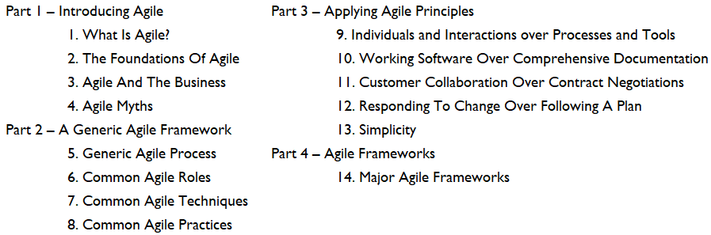
Agile Foundations
Ch | Date
1 | ddmmmyy
2
3
4
5
6
7
8
Agile Foundations 2015

Slide 3

1
What is Agile?

Slide 4
The History of Agile
‘Standing on the shoulders of giants’ is a particularly apt term when discussing the evolution of Agile, as Agile thinking is founded on the concepts and ideas behind many different IT governance and delivery frameworks.
Table 1.1 shows the evolution of these frameworks (see Chapter 14) since the late 1940s, leading to what is now generically referred to as ‘Agile’.

Slide 5
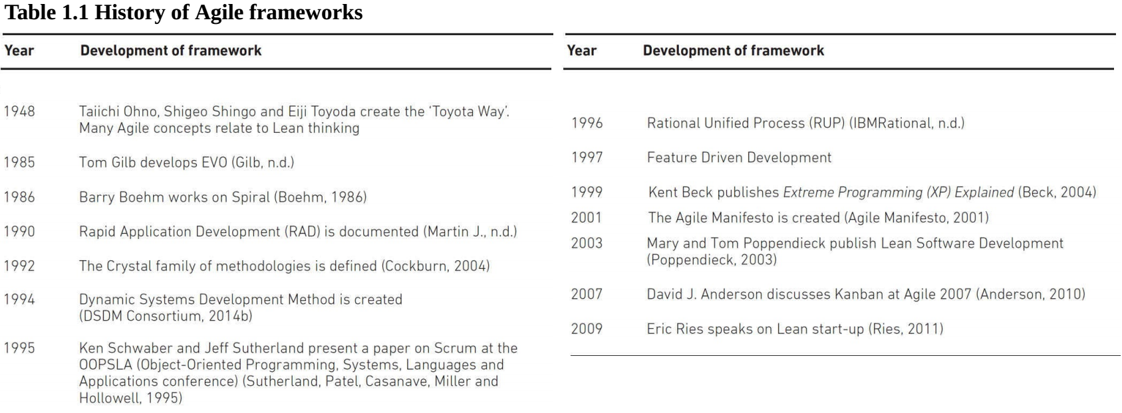
Table 1-1

Slide 6
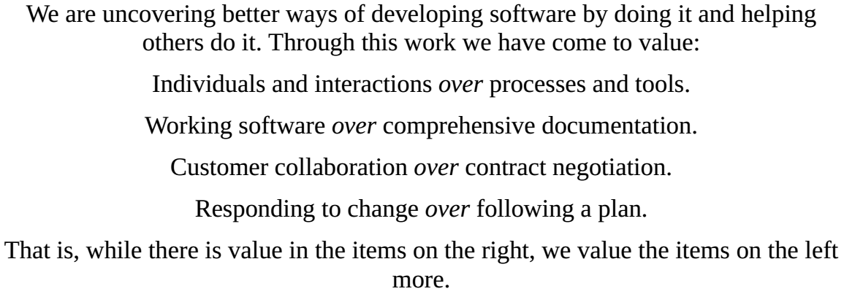
The Agile Manifesto
As mentioned in the Introduction, the Agile Manifesto provides the single definition of Agile and underlies the development and delivery of Agile frameworks.
While its title ‘The Manifesto for Agile Software Development’ suggests that it is only applicable to software development, the values and principles described in the Manifesto can easily be applied to the development of many types of product.
The Manifesto describes 4 values and 12 supporting principles.
The values set out in the Agile Manifesto are:

Slide 7
The Agile Manifesto |
Typically an Agile audit or health check will be performed against the 4 manifesto statements and the 12 manifesto principles.
It may also be further refined by the key values and principles of whatever combination of Agile frameworks (see Chapter 14) is being implemented.
In this chapter, we will take a closer look at the manifesto’s values and supporting principles.

Slide 8
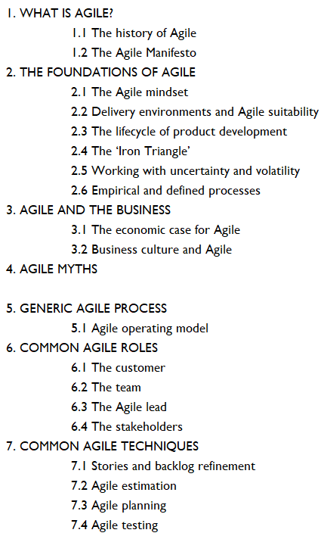
2

Slide 9
Intro

Slide 10
3

Slide 11
Intro

Slide 12
4

Slide 13
Intro

Slide 14
5

Slide 15
Intro

Slide 16
6

Slide 17
Intro

Slide 18
7

Slide 19
Intro

Slide 20
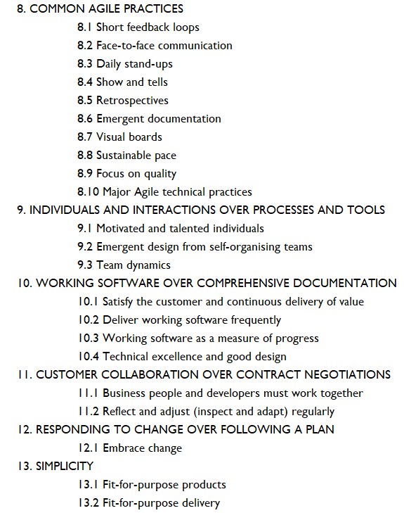
8

Slide 21
Intro

Slide 22
9

Slide 23
Intro

Slide 24
11

Slide 25
Intro

Slide 26
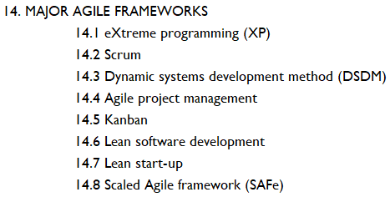
14
Major Agile Frameworks

